Slide 1
Chongqing University of Technology
ATAI
Advanced Technique of Artificial Intelligence
Chongqing University of Technology
Multimodal Emotion Recognition
Made by JiaWei Cheng

Slide 2
MM-DFN: MULTIMODAL DYNAMIC FUSION NETWORK FOR EMOTION RECOGNITIONINCONVERSATIONS(ICASSP2022)

Slide 3
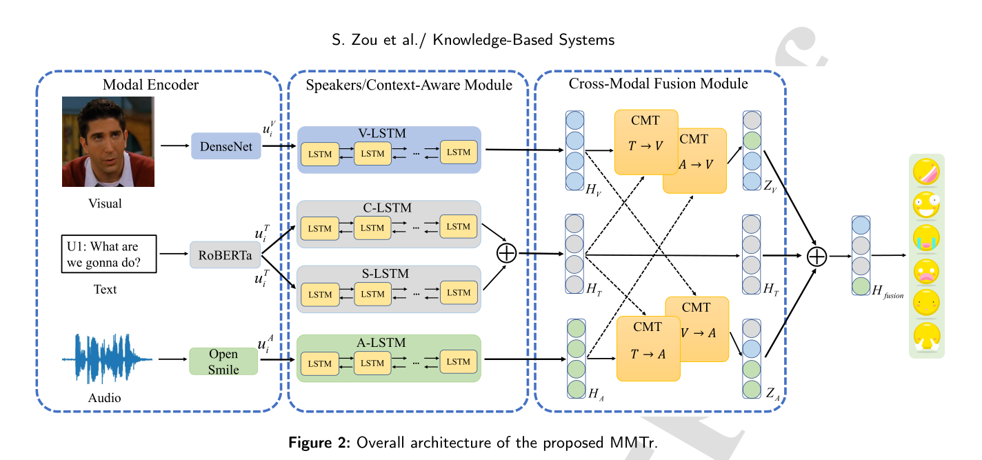
Improving Multimodal Fusion with Main Modal Transformer for Emotion Recognition in Conversation(KBS2022)

Slide 4
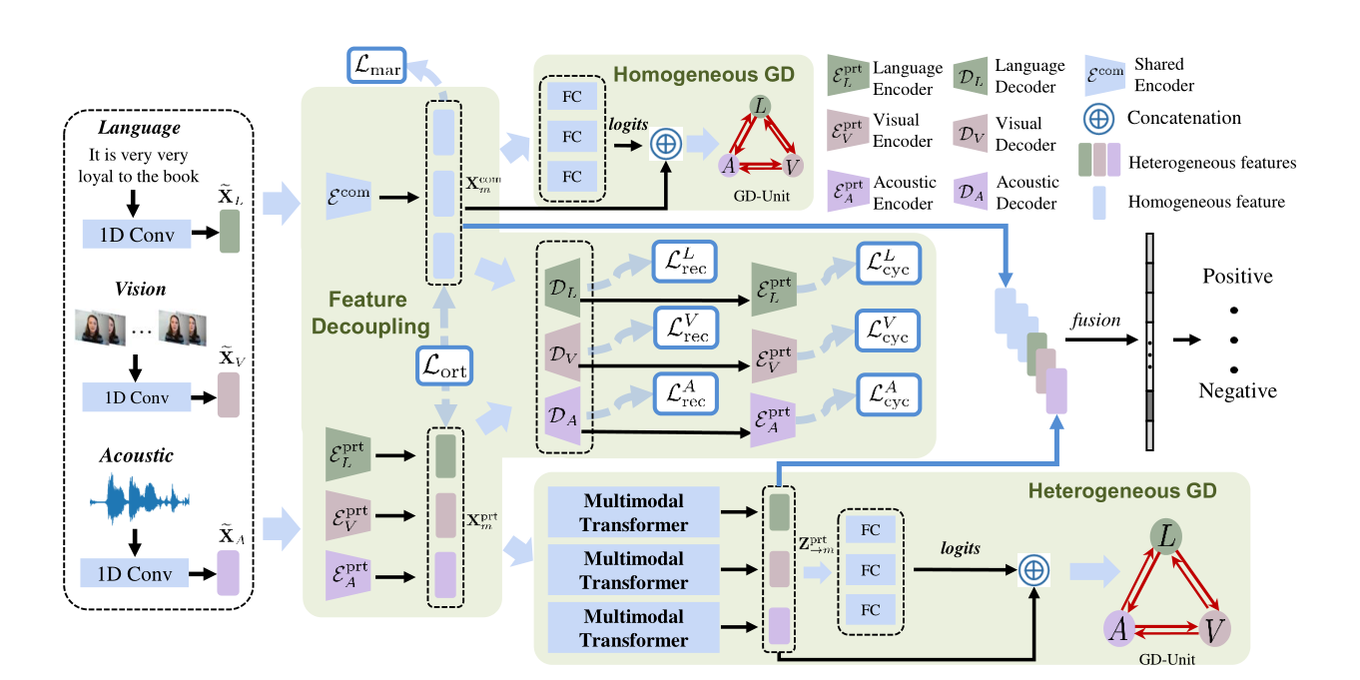
Decoupled Multimodal Distilling for Emotion Recognition(CVPR2023)
文中没有提及三个模态初始特征的提取方法

